Slide 1
Sleep Pattern Analysis
Tamil Selvan – RA2211026010124
Rujai Ananth– RA2211026010118
Sweety – RA2211026010083

Slide 2
Introduction
Data collection is a crucial step in analyzing sleep patterns to understand the
factors affecting sleep efficiency. For this study, data is collected from multiple
sources, including self-reported surveys, wearable devices, and publicly available datasets. The combination ofthese sources ensures a comprehensive understanding of sleep behaviors and their influencing factors. Understanding sleep patterns helps researchers identify trends, correlations, and potential interventions to improve sleep quality.

Slide 3
Data Collection
Primary data is collected directly from individuals using three main
methods: Google Forms surveys.
Google Forms Survey
A structured questionnaire was designed using Google Forms to collect self-
reported sleep data from participants.
1.Demographic Information: Age, gender, occupation, lifestyle habits,
geographic location, and marital status.
2.Sleep Duration : Quality: Average hours of sleep per night, frequency
of sleep disturbances, perceived sleep quality, and satisfaction level with
current sleep patterns.

Slide 4
3.Daily Routine Factors: Caffeine intake, screen time before bed, physical activity levels, work/study schedule, and exposure to blue light.
4.Health:Lifestyle Information: Stress levels, dietary habits, pre-
existing medical conditions affecting sleep, use of sleep aids, and mental
health conditions.
5. Environmental Factors: Room temperature, light and noise levels, and type of mattress and pillows used.

Slide 5
Purpose of the Case Study
The purpose of this case study is to analyze sleep patterns by collecting and examining data from multiple sources, including self-reported surveys datasets. By integrating data from these sources, the study aims to identify key factors affecting sleep efficiency, uncover trends and correlations, and explore potential interventions to enhance sleep quality

Slide 6
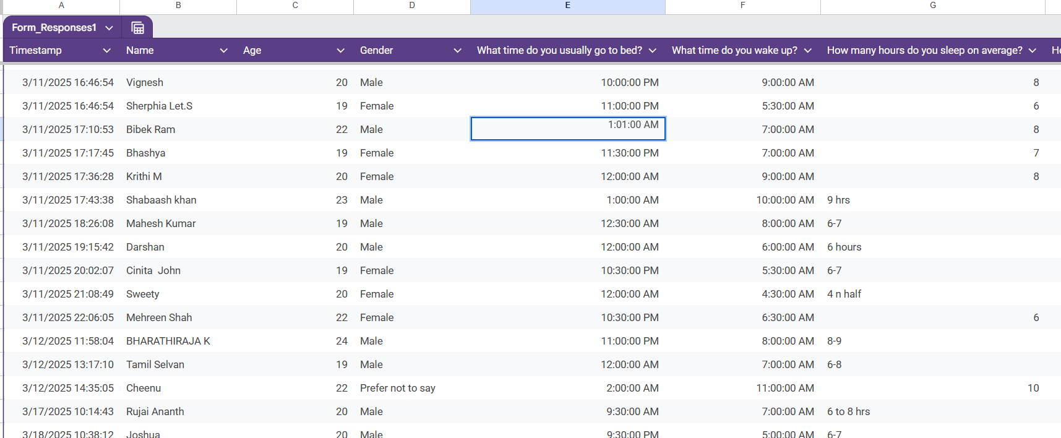
Data Set

Slide 8
Conclusion
This case study highlights the significance of collecting comprehensive sleep data to analyze sleep patterns effectively. Despite challenges such as data reliability, privacy concerns, and integration issues, leveraging multiple data sources provides valuable insights into sleep behaviors. Understanding these patterns can help researchers develop targeted interventions to improve sleep quality and overall well-being. Future studies can further refine data collection techniques and incorporate advanced machine learning models for more accurate sleep analysis.

